Slide 1
Network and Cyber Security-I (CY2001) (Lecture 16 and 17)
Dr. Qaisar Shafi
Department of Computer Science,
National University of Computer & Emerging Sciences, Islamabad Campus

Slide 2
“Symmetric ciphers modes of operation”
Threats on Public Key(Public Key Infrastructure)

Slide 3
Multiple Encryptions
Technique in which an encryption algorithm is used multiple times.
In the first instance, plaintext is converted to cipher text using the encryption algorithm, this ciphertext is used as input and the algorithm is applied again.
The process is repeated through and number of stages.

Slide 4

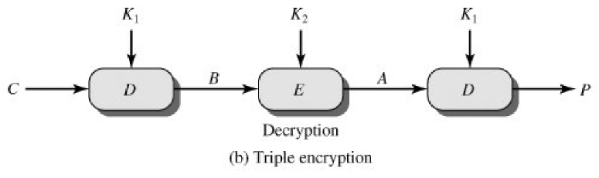
Triple DES

Slide 5
Block Cipher Encryption
Because block cipher operate on fixed-size blocks of data, if the original plaintext message is longer than the block size, it must be split into blocks so that each block is the size of the block length defined by the block cipher
Each block is then processed by the block cipher
If the plaintext is not a multiple of the block length, the plaintext is padded so that the total length of the plaintext is a multiple of the block length
Some mechanism of encoding the length of the plaintext that is the final block may be stored or transmitted, so that the padding in the final block is discarded when the data is decrypted

Slide 6
Block Cipher Encryption
Key k
Plaintext
Padding
p₀
p₁
p₂
p₃
p₄
p₅
F
F
F
F
F
F
c₀
c₁
c₂
c₃
c₄
c₅
Notes:
This is an example of Electronic Codebook (ECB) encryption.

Slide 7
Block cipher Modes of Operation
A block cipher is a basic building block for data security.
Four “modes of operation” have been defined by NIST.
Used to enhance the effect of cryptographic algorithms or adapting the algorithm for application.
The 4 modes covers all the possible applications for encryption for which block ciphers can be used.
With new applications NIST expanded the list to five modes.
These modes are intended to use with symmetric block cipher , including triple DES and AES.

Slide 8
Modes of Operation
A block cipher can be used in various methods for data encryption and decryption; these methods are called modes of operation
Four well-known block cipher modes of operation are:
Electronic Codebook (ECB)
Ciphertext Block Chaining (CBC)
Ciphertext Feedback (CFB)
Output Feedback (OFB)
The same key is used for the block cipher regardless of the mode of operation (i.e., mode of operations never change the key used for encryption or decryption)

Slide 9
Electronic Codebook (ECB)
This is the simplest mode, in which plaintext blocks are processed independently of one other
Plaintext is handled one block at a time and each block of plaintext is encrypted using the same key.
Codebook , for a given key, there is unique ciphertext for every b-bit block of plaintext.
For a message longer than b bits, is simply to break message into b-bits block , padding the last block if necessary.
Decryption is performed one block at a time, using the same key.
Let the plaintext sequence be denoted by P = (p₁, p₂, p₃, …, p_{n}) and the corresponding ciphertext sequence by C = (c₁, c₂, c₃, …, c_{n}); the key is denoted by K and the block cipher is denoted by the function F
Electronic Codebook (ECB) mode:
Encryption: c_{i} = F(p_{i}, K)
Decryption: p_{i} = F⁻¹(c_{i}, K)
For i= 1, 2, …, n

Slide 10
ECB mode encryption
p₁
p₂
p₃
p₄
p₅
F_{k}
F_{k}
F_{k}
F_{k}
F_{k}
c₁
c₂
c₃
c₄
c₅

Slide 11
ECB mode decryption
c₁
c₂
c₃
c₄
c₅
F_{k}^{–1}
F_{k}^{–1}
F_{k}^{–1}
F_{k}^{–1}
F_{k}^{–1}
p₁
p₂
p₃
p₄
p₅

Slide 12
ECB
The ECB method is ideal for short amount of data , such as encryption key.
The most significant characteristic of ECB is that the same b-bits block of plaintext , if it appear more than once in a message , always produce the same ciphertext.
For lengthy message , the ECB is not secure. If the message is highly structured , it may be possible to exploit these regularities.
For example, if it is known that the message always starts with certain predefined fields, then the cryptanalytic may have number of known paintext-ciphertext pairs to work with.

Slide 13
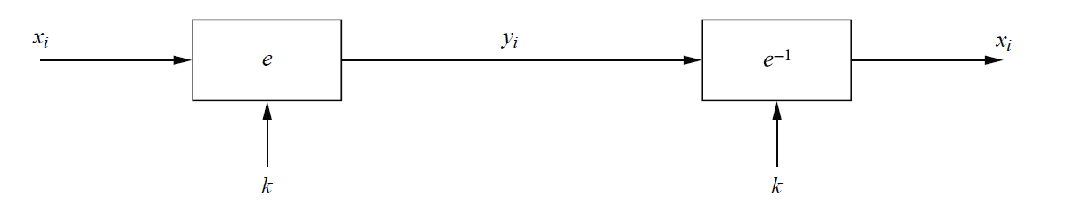
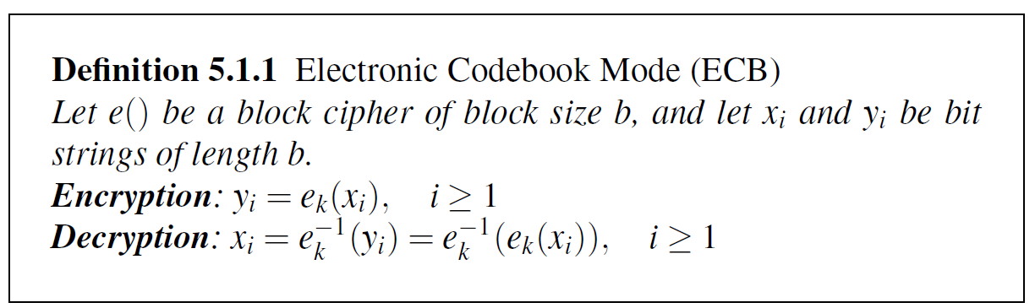
ECB

Slide 14
Cipher text Block Chaining (CBC)
To overcome security deficiencies of ECB, we would like a technique in which the same plaintext, if repeated, produces different ciphertext blocks.
In this scheme, the input to the encryption algorithm is the XOR of the current plaintext and the proceeding ciphertext block; the same key is used for each block.
In effect, we have chain together the sequence of plaintext blocks.
The input to the encryption function for each plaintext block bears no fixed relationship to the plaintext block. Therefore, repeating patterns of b bits are not exposed.
An initialisation vector (IV) is a value chosen by the sender that is equal to the block length; its value does not have to be kept secret, but the receiver must know it.
To produce the first block of ciphertext , an IV is XORed with the first block of plaintext.
On decryption, the IV is XORed with the output of the decryption algorithm to recover the first block of plaintext.

Slide 15

CBC
The IV is denoted by c_{o}
Ciphertext Block Chaining (CBC) mode:
Encryption: c_{i} = F(p_{i} c_{i–1}, K)
Decryption: p_{i} = F^{–1}(c_{i}, K) c_{i-1}
For i = 1, 2, …, n
The IV must be known to both the sender and receiver, the IV should be protected against unauthorized changes, the can be done by sending the IV using ECB encryption.

Slide 16
CBC mode encryption
p₁
p₂
p₃
p₄
p₅
F_{k}
F_{k}
F_{k}
F_{k}
F_{k}
c₀
c₁
c₂
c₃
c₄
c₅
Notes:
This is an example of Electronic Codebook (ECB) encryption.

Slide 17
CBC mode decryption
p₁
p₂
p₃
p₄
p₅
F_{k}^{–1}
F_{k}^{–1}
F_{k}^{–1}
F_{k}^{–1}
F_{k}^{–1}
c₀
c₁
c₂
c₃
c₄
c₅
Notes:
This is an example of Electronic Codebook (ECB) encryption.

Slide 18
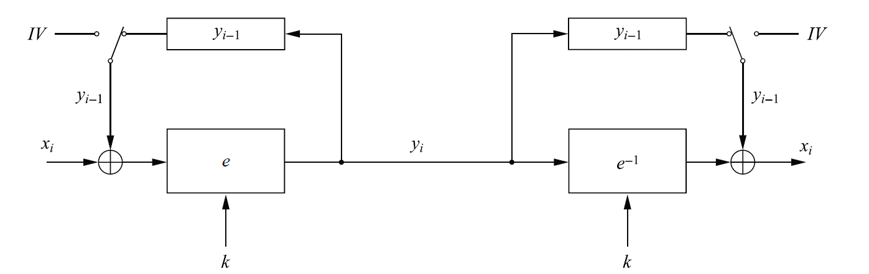
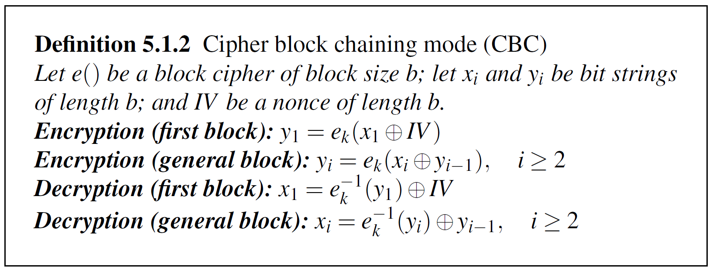
CBC

Slide 19
Cipher text Feedback(CFB)
DES uses a b-bit blocks.
However, it is possible to convert DES into a stream cipher , using either the CFB or output feedback.
The stream cipher eliminates the need to pad a message to integral number of blocks.
It can be operate in real time.
Thus if a character stream is being transmitted , each character can be encrypted and transmitted immediately using a character-oriented stream cipher.

Slide 20
CFB
One property of stream cipher is that ciphertext be of the same length as the plaintext.
If 8-bit character has to be transmitted, each character should be encrypted to produce a ciphertext output of 8 bit. If more than 8 bits are produced , transmission capacity is wasted.

Slide 21
CFB
Assume , unit of transmission is s bits, s=8.
As with CBC, the units of plaintext are chained together, so that the ciphertext of any plaintext units is a function of all the preceding plaintext.
In this case, rather than units of b bits, the plaintext is divided into segment of s bits.
Encryption, the input to the encryption function is a b-bit shift register that is initially set to some IV.
The leftmost (most significant ) s bits of the output of the encryption function are XORed with the first segment of plaintext P1 to produce the first unit of cipertext C1, which is then transmitted.
In addition, the content of the shift register are shifted left by s bits and C 1 is placed in the rightmost (least significant) s bits of the shift register.
This process continues untill all plaintext units are encrypted.

Slide 22
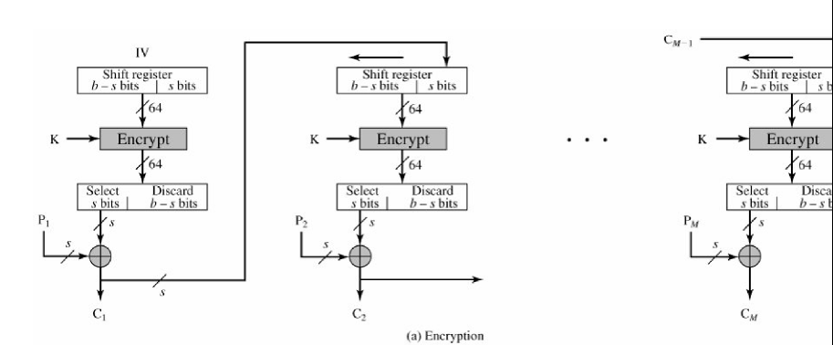
CFB Encryption

Slide 23
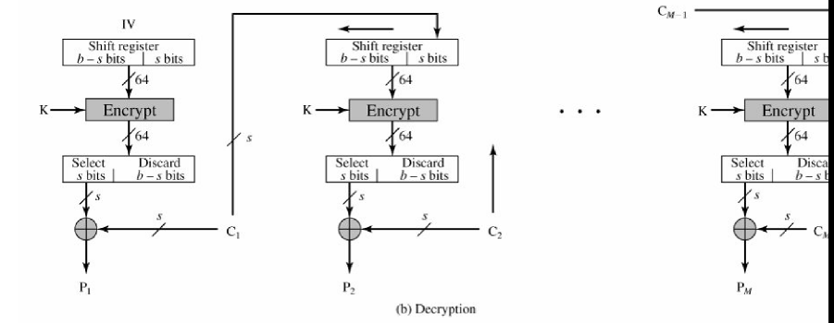
CFB Decryption

Slide 24
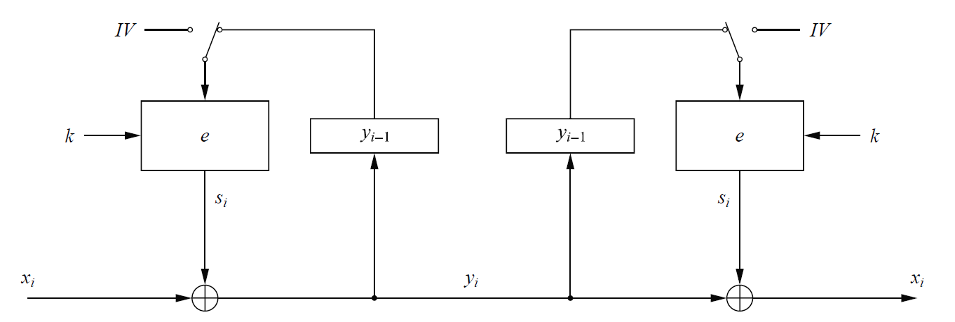
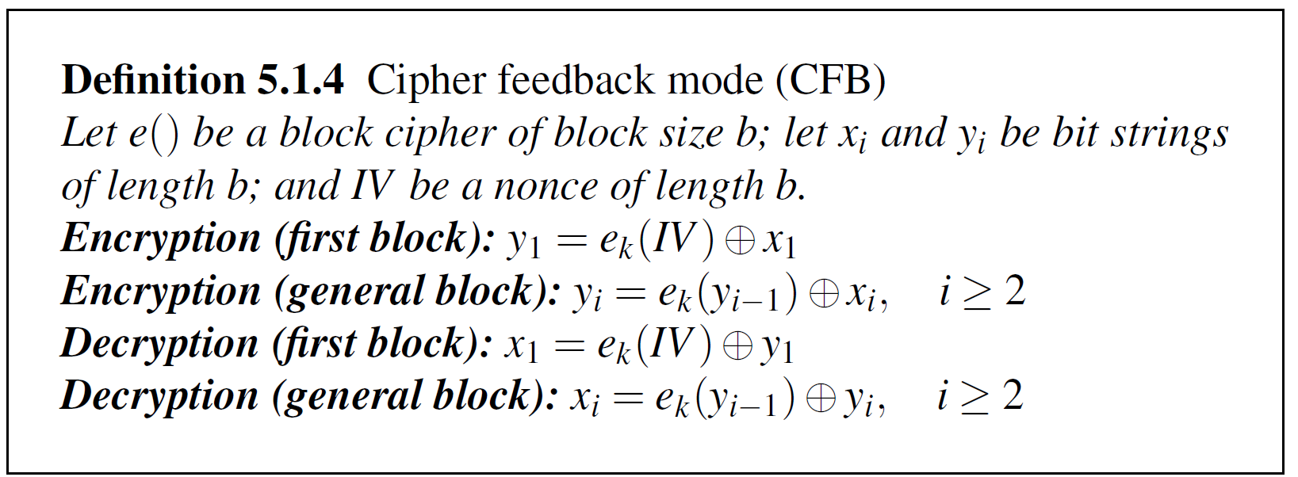
CFB

Slide 25
Output Feedback Mode
The output Feedback (OFB) mode is similar in structure to CFB.
It is the output of the encryption function that is feed back to shift register in OFB , whereas in CFB the cipher text units is feed back to the shift register.
Advantage , bit error do not propagate, e.g. if a bit error occur in C1, only the recovered value of P1 is affected; subsequent plaintext units are not corrupted.
With CFB, C1 also serves as input to the shift register and therefore causes additional corruption.

Slide 26
OFB
Disadvantage, more vulnerable to a message stream modification attack. Consider complementing a bit in the ciphertext complements the corresponding bit in the recovered plaintext. Thus controlled changes can be made.
So it is possible for an opponent, by making the necessary changes to the checksum portion of the message as well as the data portion, to alter the ciphetext in such a way that it is not detected by an error-correcting code.

Slide 27
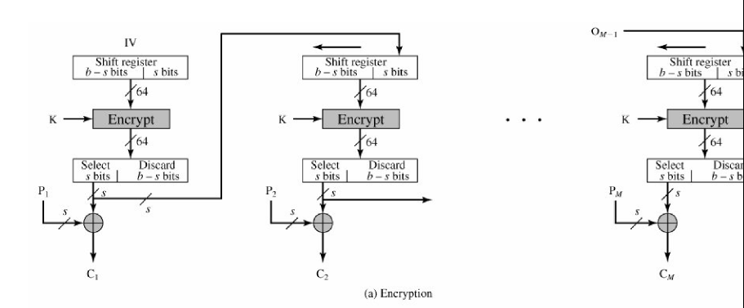
OFB Encryption

Slide 28
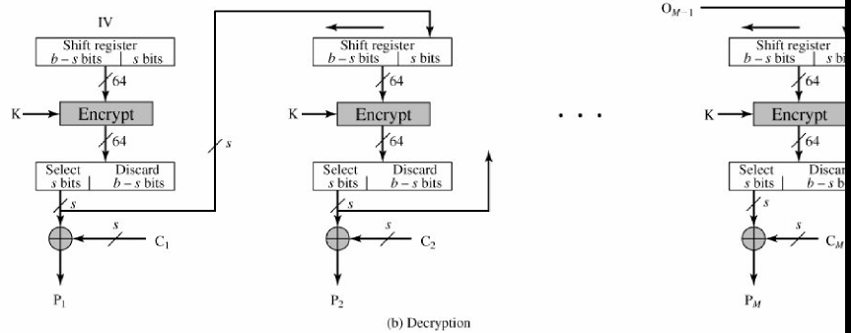
OFB Decryption

Slide 29
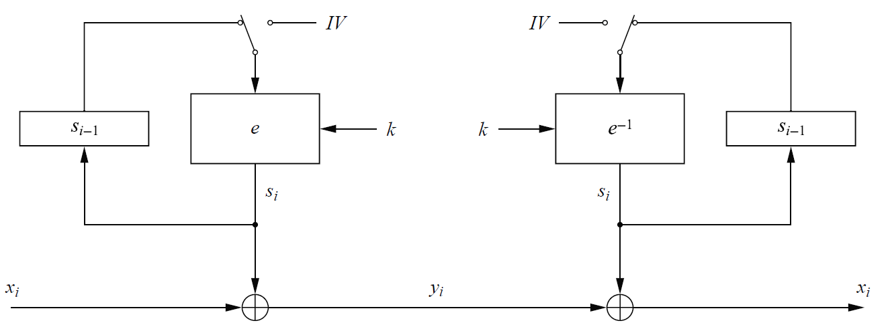
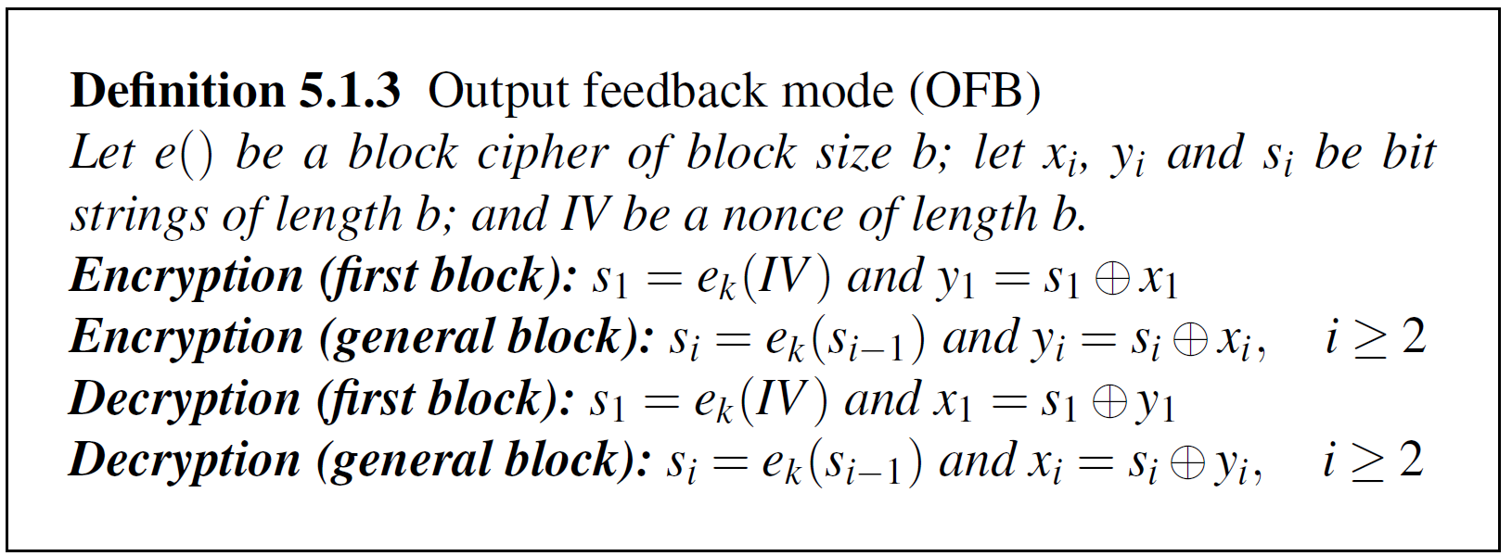
OFB

Slide 30
Counter Mode
In CTR mode, a counter equal to the plaintext block size is used.
The only requirement is that counter value must be different for each plaintext block that is encrypted.
Typically, it is initialed to some value and than encrypted by 1 for each block(mod 2 ^{b} , where b is the block size)
For encryption, the counter is encrypted and then XORed with the PT to produce CT; there is no chaining.
For decryption, the same sequence of counter values is used, with each encrypted counter XORed with a ciphertext block to recover the corresponding plaintext block.

Slide 31
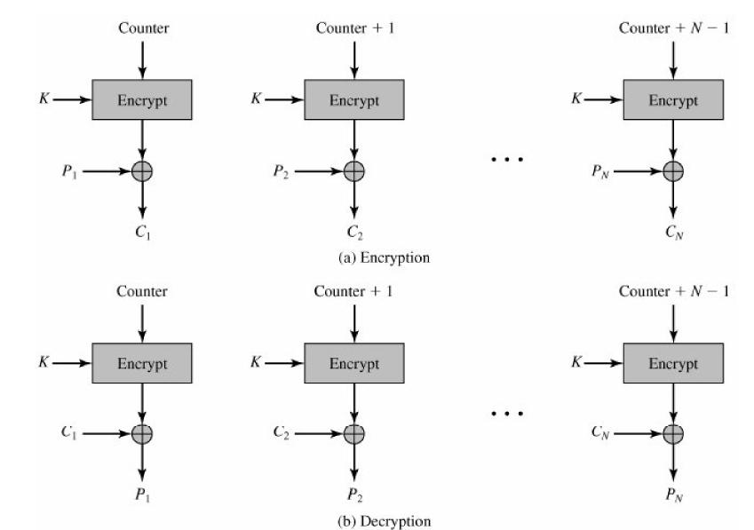
Counter Mode Encryption and Decryption

Slide 32
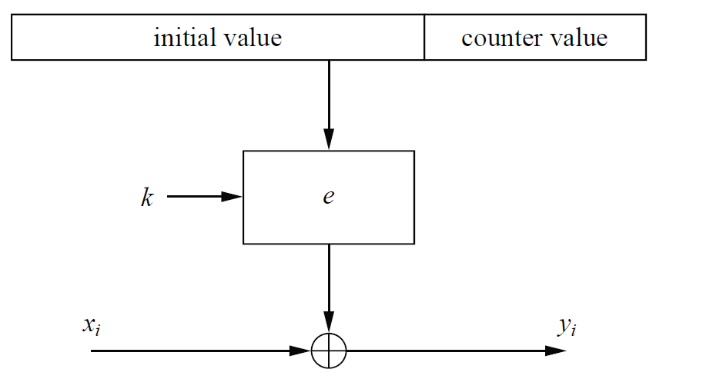
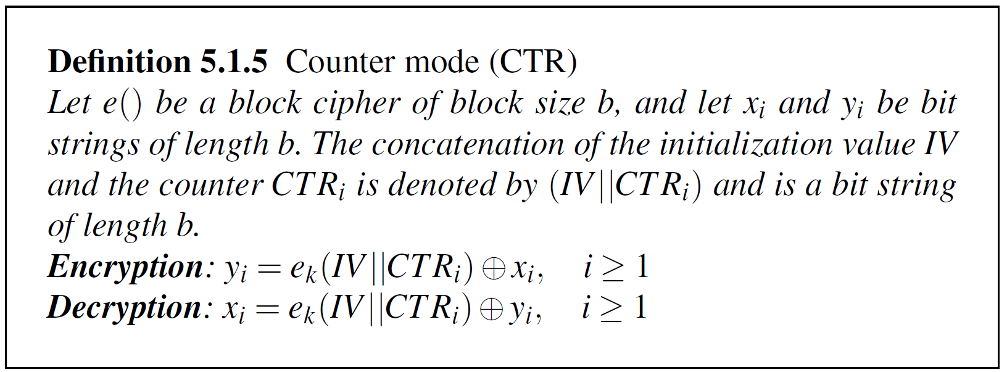
Counter Mode (CTR)

Slide 33
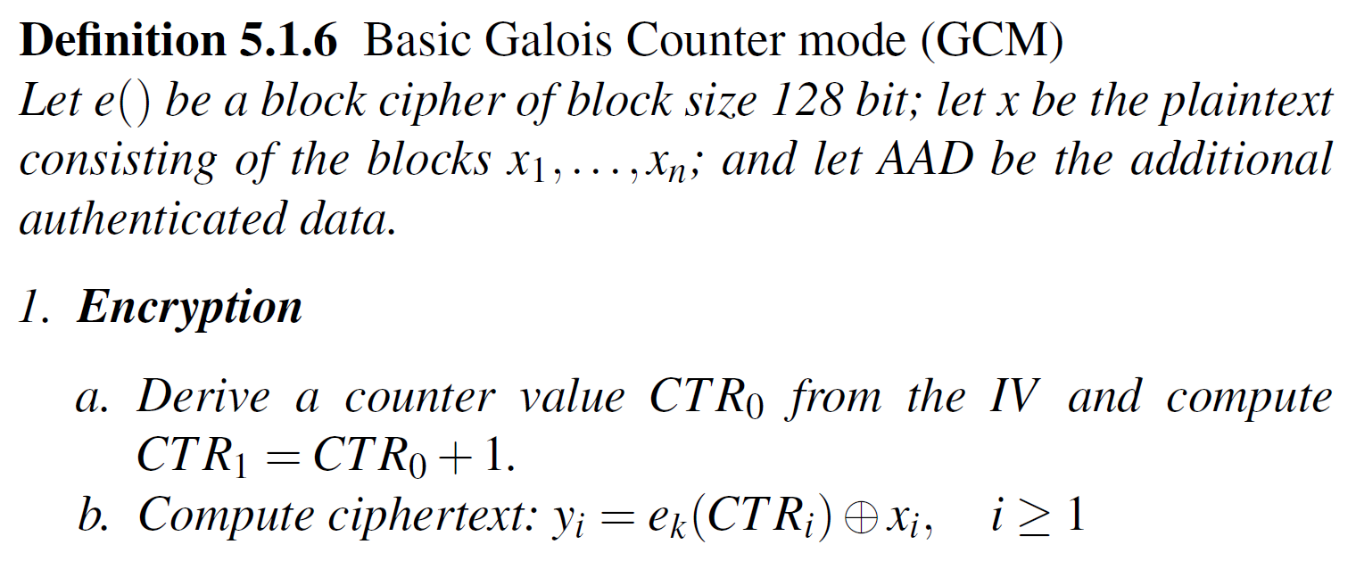
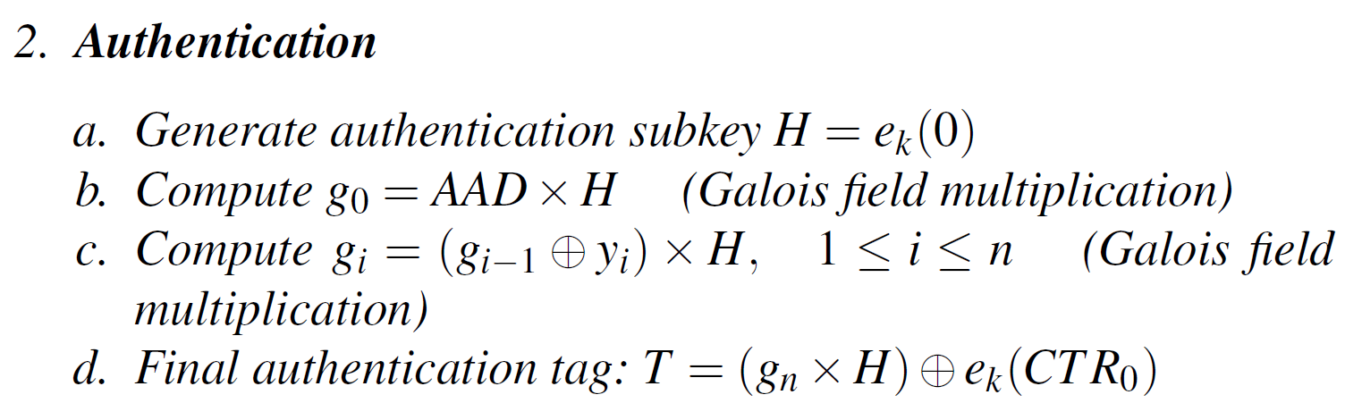
Galois Counter Mode (GCM)

Slide 34
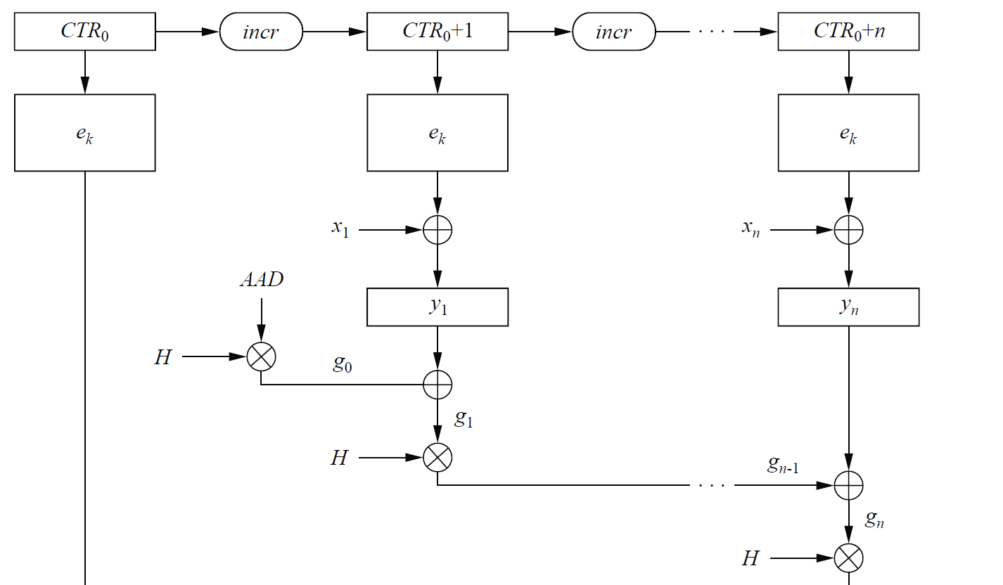
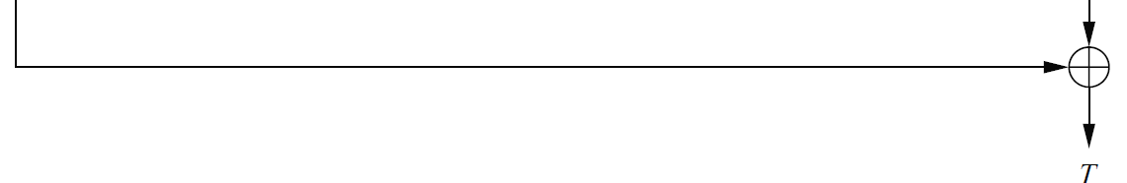
Galois Counter Mode (GCM)

Slide 35
(Key Management)

Slide 36
Key Management
One of the major roles of public-key encryption has been to address the problems of key distribution.
Two distinct aspects of public key cryptography:
The distribution of public keys
The use of public key encryption to distribute secret keys

Slide 37
Distribution of Public keys
Public announcements
Publicly available directory
Public key authority
Public key certificates

Slide 38
Public Key Infrastructure (PKI)

Slide 39
PKI
The Public Key Infrastructure (PKI) is a set of hardware, software, people, policies, and procedures needed to create, manage, store, distribute, and revoke digital certificates based on public key cryptography

Slide 40
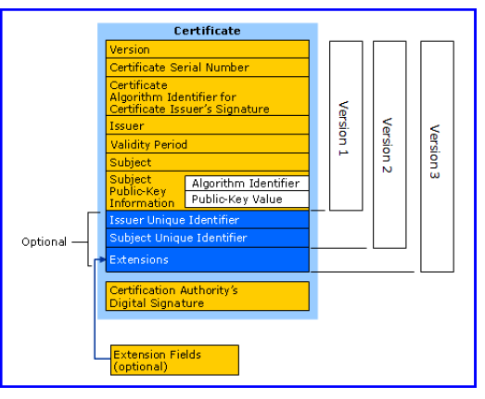
Digital Certificate

Slide 41
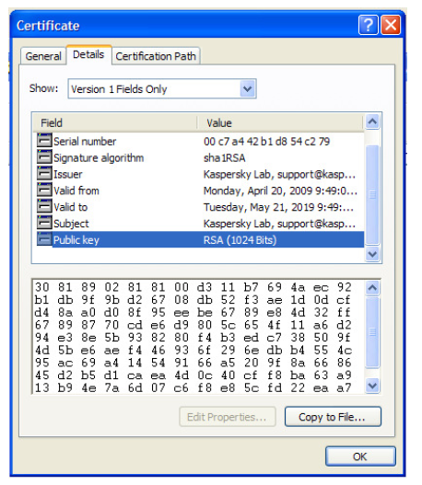
Digital Certificate

Slide 42
Any Questions ?

